Slide 1
Neural Networks & Genetic Algorithms
Bujor Pavaloiu

Slide 2
Content (1)
1. Artificial Intelligence, Machine Learnig, Connectionist paradigm
2. McCulloch & Pitts neuron model. Perceptron
3. Adaptive Linear Neurons
4. Feed-Forward Neural Networks, Backpropagation
5. Deep Learning
6. Keras Framework. MNIST and CIFAR 10.
7. Competitive Learning. Kohonen Self-Organizing Networks

Slide 3
Unsupervised learning
Training samples contain only input patterns
No desired output is given (teacher-less)
Learn to form classes/clusters of sample patterns according to similarities among them
Patterns in a cluster would have similar features
No prior knowledge as what features are important for classification, and how many classes are there.

Slide 4
Competitive Learning
Competitive learning is a type of unsupervised learning in Artificial Neural Networks, where the nodes compete for the right to respond to a subset of the input data and to represent it.
competition layer
input layer

Slide 5
NN Based on Competition
Competition is important for NN
Competition between neurons has been observed in biological nerve systems
Competition is important in solving many problems
To classify an input pattern into one of the m classes
idea case: one class node has output 1, all other 0 ;
often more than one class nodes have non-zero output
x_1
C_1
x_n
C_m
INPUT
CLASSIFICATION
If these class nodes compete with each other, maybe only one will win eventually and all others lose (winner-takes-all). The winner represents the computed classification of the input

Slide 6
Winner-takes-all principle
Neurons start with randomly distributed synaptic weights
Neurons compete for the right to respond to a given subset of inputs, such that only one output neuron (or only one neuron per group), is active (i.e. "on") at a time. The neuron that wins the competition is called a "winner-take-all" neuron.
A limit is imposed on the "strength" of each neuron
Accordingly, the individual neurons of the network learn to specialize on ensembles of similar patterns and in so doing become 'feature detectors' for different classes of input patterns.

Slide 7
Winner-takes-all principle
Winner neuron - the neuron that detects the strongest similarity between its weight vector and the input pattern, obtains activation 1. Activation 0 is assigned to all other output neurons.
Similarity between the input vector i and the weight vector w_{j} is assessed by the inner product.
The input pattern corresponds to the n-dimensional vector i.
The weights leading from the input layer to a neuron j of the competition layer may also be interpreted as an n-dimensional vector w_{j}

Slide 8
Training:
Train the network such that the weight vector w_{j} associated with jth output node becomes the representative vector of a class of similar input patterns.
Initially all weights are randomly assigned
Two phase unsupervised learning
competing phase:
apply an input vector i_{l} randomly chosen from sample set.
compute output for all output nodes: o_{j} = i_{l} w_{j}
determine the winner j* among all output nodes (winner is not given in training samples so this is unsupervised)
rewarding phase:
the winner is reworded by updating its weights w_{j} to be closer to i_{l} (the weights associated with all other output nodes are not updated: kind of WTA)
repeat the two phases many times (and gradually reduce the learning rate) until all weights are stabilized.

Slide 9
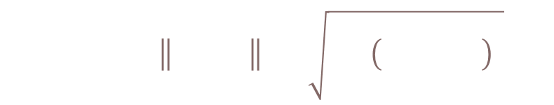
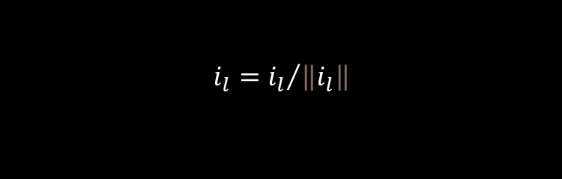
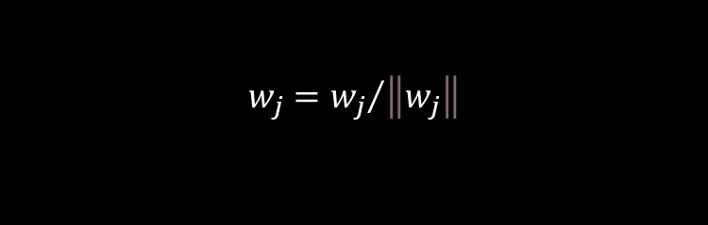
Weight update:
Method 1: Method 2
In each method, w_{j} is moved closer to i_{l}
Normalize the weight vector to unit length after it is updated
Sample input vectors are also normalized
Distance
$$w_{j}=w_{j}+Δw_{j}$$
$$Δw_{j}=η (i_{l}−w_{j})$$
$$Δw_{j}=η i_{l}$$
i_{l} – w_{j}
η (i_{l} - w_{j})
i_{l} + w_{j}
i_{l}
i_{l}
ηi_{l}
w_{j}
w_{j} + η(i_{l} - w_{j})
w_{j}
w_{j} + ηi_{l}
$$w_{j}={w_{j}}/{\left\|w_{j}\right\|}$$
$$i_{l}={i_{l}}/{\left\|i_{l}\right\|}$$
$$i_{l}−w_{j}={\left\|i_{l}−w_{j}\right\|}_{2}=\sqrt{\sum_{i}{{\left(i_{l,i}−w_{j,i}\right)}^{2}}}$$

Slide 10

$w_{j}$ is moving to the center of a cluster of sample vectors after repeated weight updates
Node j wins for three training
samples: i₁ , i₂ and i₃
Initial weight vector w_{j}(0)
After successively trained
by i₁ , i₂ and i₃ ,
the weight vector
changes to w_{j}(1),
w_{j}(2), and w_{j}(3),
w_{j}(0)
w_{j}(3)
i₃
w_{j}(1)
i₁
w_{j}(2)
i₂

Slide 11



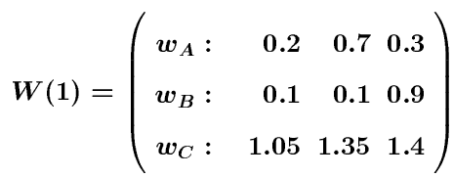


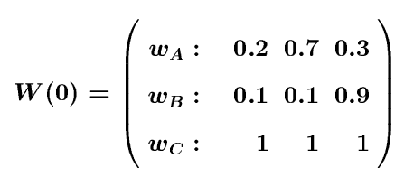

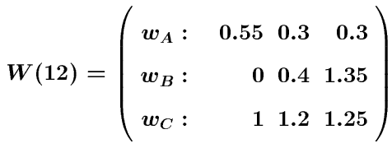
Examples
A simple example of competitive learning
6 vectors of dimension 3 in 3 classes (6 input nodes, 3 output nodes)
Weight matrices:
Node A: for class {i₂, i₄, i₅}
Node B: for class {i₃}
Node C: for class {i₁, i₆}

Slide 12

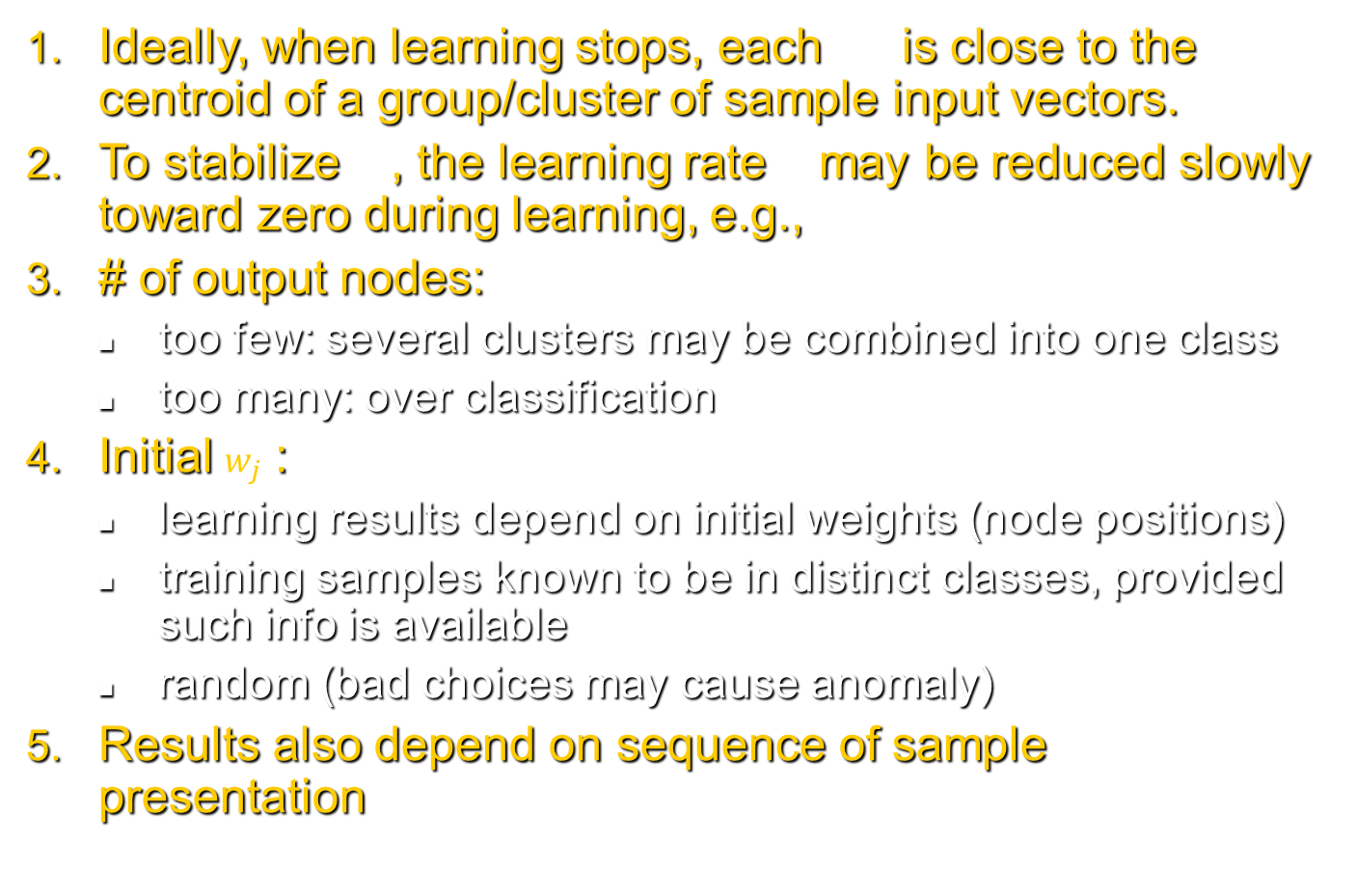



Comments
Ideally, when learning stops, each is close to the centroid of a group/cluster of sample input vectors.
To stabilize , the learning rate may be reduced slowly toward zero during learning, e.g.,
# of output nodes:
too few: several clusters may be combined into one class
too many: over classification
Initial $w_{j}$ :
learning results depend on initial weights (node positions)
training samples known to be in distinct classes, provided such info is available
random (bad choices may cause anomaly)
Results also depend on sequence of sample presentation
$$w_{j}$$
$$w_{j}$$
$$η$$
$$η(t+1)≤η(t)$$

Slide 13


Example
will always win no matter the sample is from which class
is stuck and will not participate in learning
unstuck:
let output nodes have some conscience
temporarily shot off nodes which have had very high winning rate (hard to determine what rate should be considered as “very high”)
w₂
$$w_{1}$$
w₁
$$w_{2}$$

Slide 14
Example
Results depend on the sequence of sample presentation
w₂
w₁
w₂
Solution:
Initialize w_{j} to randomly selected input vectors that are far away from each other
w₁

Slide 15
Self-Organizing Maps (SOM)
Competitive learning (Kohonen 1982) is the basic idea for SOM (Kohonen 1989)
In competitive learning,
the network is trained to organize input vector space into subspaces/classes/clusters
each output node corresponds to one class
the output nodes are not ordered: random map
cluster_1
The topological order of the three clusters is 1, 2, 3
The order of their maps at output nodes are 2, 3, 1
The map does not preserve the topological order of the training vectors
cluster_2
w_2
w_3
cluster_3
w_1

Slide 16

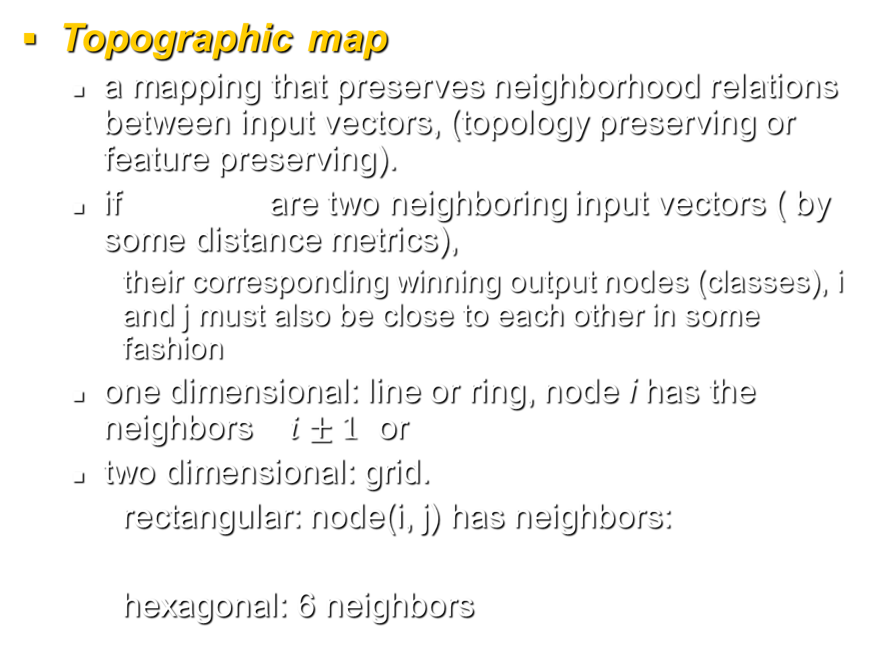
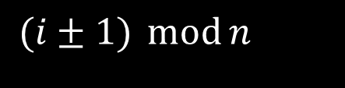
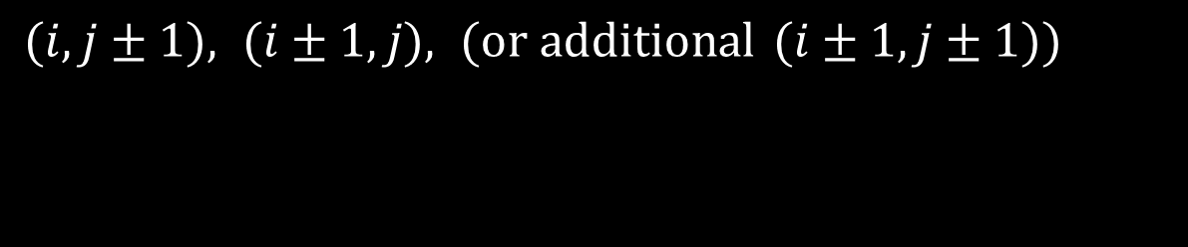

Topographic map
a mapping that preserves neighborhood relations between input vectors, (topology preserving or feature preserving).
if are two neighboring input vectors ( by some distance metrics),
their corresponding winning output nodes (classes), i and j must also be close to each other in some fashion
one dimensional: line or ring, node i has the neighbors $i±1$ or
two dimensional: grid.
rectangular: node(i, j) has neighbors:
hexagonal: 6 neighbors
$$i_{1} \text{and} i_{2}$$
$$i±1$$
$$(i±1) \operatorname{mod}{n}$$
$$(i,j±1), (i±1,j), (\text{or} \text{additional} (i±1,j±1))$$

Slide 17
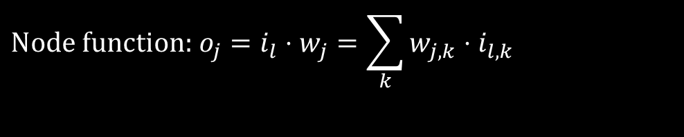
SOM Architecture
Two layer network:
Output layer:
Each node represents a class (of inputs)
Neighborhood relation is defined over these nodes
N_{j}(t): set of nodes within distance D(t) to node j.
Each node cooperates with all its neighbors and competes with all other output nodes.
$$\text{Node} \text{function}\text{: }o_{j}=i_{l}⋅w_{j}=\sum_{k}{w_{j,k}⋅i_{l,k}}$$

Slide 18
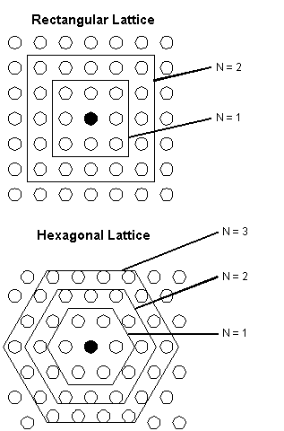
Topographic Map - Lattice Structure of SOM
N represents the link distance

Slide 19
Biological motivation
Mapping two dimensional continuous inputs from sensory organ (eyes, ears, skin, etc) to two dimensional discrete outputs in the nerve system.
Retinotopic map: from eye (retina) to the visual cortex.
Tonotopic map: from the ear to the auditory cortex
These maps preserve topographic orders of input.
Biological evidence shows that the connections in these maps are not entirely “pre-programmed” or “pre-wired” at birth. Learning must occur after the birth to create the necessary connections for appropriate topographic mapping.

Slide 20
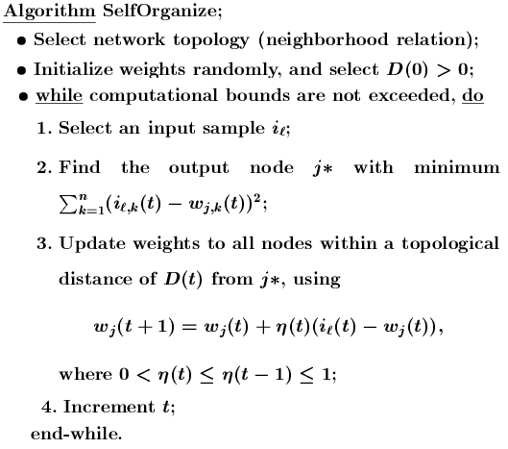

Slide 21









Notes
Initial weights: small random value from (-e, e)
Reduction of :
Linear:
Geometric:
Reduction of D:
should be much slower than reduction.
D can be a constant through out the learning.
Effect of learning
For each input i, not only the weight vector of winner
is pulled closer to i, but also the weights of ’s close neighbors (within the radius of D).
Eventually, becomes close (similar) to . The classes they represent are also similar.
May need large initial D in order to establish topological order of all nodes
$$η$$
$$η (t+1)=η (t)−Δη$$
$$η (t+1)=η (t)⋅β \text{where} 0<β<1$$
$$D(t+Δt)=D(t)−1 \text{while} D(t)>0$$
$$η$$
$$j^{∗}$$
$$j^{∗}$$
$$w_{j}$$
$$w_{j±1}$$

Slide 22

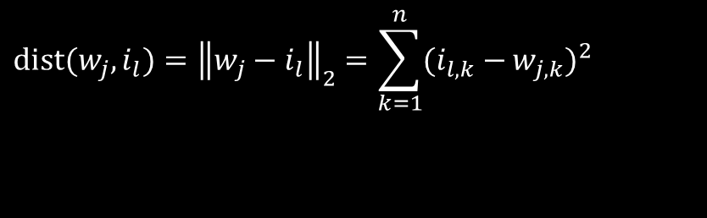

Notes
Find j* for a given input i_{l}:
With minimum distance between w_{j} and i_{l}.
Distance:
Minimizing dist(w_{j}, i_{l}) can be realized by maximizing
$$\text{dist}(w_{j},i_{l})={\left\|w_{j}−i_{l}\right\|}_{2}=\sum_{k=1}^{n}{(i_{l,k}−}w_{j,k})^{2}$$
$$o_{j}=i_{l}⋅w_{j}=\sum_{k}{w_{j,k}⋅i_{l,k}}$$
$$−\text{dist}(w_{j},i_{l})=−\sum_{k=1}^{n}{(i_{l,k}^{2}+}w_{j,k}^{2}−2i_{l,k}⋅w_{j,k}) \\ =−\sum_{k=1}^{n}{i_{l,k}^{2}−}\sum_{k=1}^{n}{w_{j,k}^{2}+}2\sum_{k=1}^{n}{i_{l,k}⋅w_{j,k}} \\ =2\sum_{k=1}^{n}{i_{l,k}⋅w_{j,k}}−2 \\ =2i_{l}⋅w_{j}−2$$

Slide 23





Examples
A simple example of competitive learning
6 vectors of dimension 3 in 3 classes, node ordering: B – A – C
Initialization: , weight matrix:
D(t) = 1 for the first epoch, = 0 afterwards
Training with
determine winner: squared Euclidean distance between
$$W(0)=\left[\begin{aligned}&w_{A}:0.2\text{ 0}.7 0 .3 \\ &w_{B}:0.\text{1} \text{ 0}.1 0.9 \\ &w_{C}:1 \text{1 } \text{ 1}\end{aligned}\right]$$
$$η=0.5$$
$$i_{1}=(1.1,1.7,1.8)$$
$$i_{1} \text{and} w_{j}$$
$$d_{A,1}^{2}=(1.1−0.2)^{2}+(1.7−0.7)^{2}+(1.8−0.3)^{2}=4.1$$
$$d_{B,1}^{2}=4.4,{ d}_{C,1}^{2}=1.1$$
C wins, since D(t) = 1, weights of node C and its neighbor A are updated, but not w_{B}
B A C

Slide 24



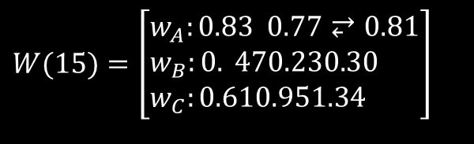
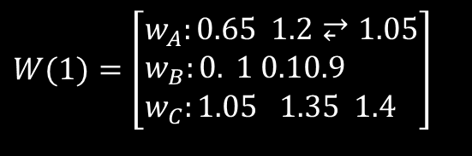
Examples
$$W(0)=\left[\begin{aligned}&w_{A}:0.2\text{ 0}.7⥂0⥂.3 \\ &w_{B}:0.\text{ 1 0}.10.9 \\ &w_{C}:1\text{ 1 1}\end{aligned}\right]$$
$$W(1)=\left[\begin{aligned}&w_{A}:0.65 1.2⥂1.05 \\ &w_{B}:0.\text{ 1} 0.10.9 \\ &w_{C}:1.05\text{ 1.35 1.4}\end{aligned}\right]$$
$$W(15)=\left[\begin{aligned}&w_{A}:0.83 0.77⥂0.81 \\ &w_{B}:0.\text{ 47}0.230.30 \\ &w_{C}:0.610.951.34\end{aligned}\right]$$
$W\left(0\right) W(15)$ $$\left|w_{A}−w_{B}\right|=0.85 1.28 \\ \left|w_{B}−w_{C}\right|=1.28 1.75 \\ \left|w_{C}−w_{A}\right|=1.22 0.80$$
Observations:
Distance between weights of non-neighboring nodes (B, C) increase
Input vectors switch allegiance between nodes, especially in the early stage of training
$$t A B C \\ 1−6 \left(3,5\right) \left(2,4\right) (1,6) \\ 7−12 \left(6\right) \left(2,4,5\right) (1,3) \\ 13−16 \left(6\right) \left(2,4,5\right) (1,3)$$

